Slide 1
Docker

Slide 2
What is Docker? And Why?
Docker is a container technology: A tool for creating and managing containers
The same container always yields the exact same
application and execution behavior! No matter where or by whom it might be executed.
Container
A standardized unit of software
Support for Containers is built into modern operating systems!
A package of code and dependencies to run that code (e.g. NodeJS code + the NodeJS runtime)
Docker simplifies the creation and management of such containers

Slide 3
Why Containers?
Why would we want independent, standardized “application packages”?
Different Development G Production Environments
Different Development Environments Within a Team / Company
Clashing Tools / Versions Between Different
Projects
We want to build and test in exactly (!) the same environment as we later run our app in
Every team member should have the exactly (!) same environment when working on the same project
When switching between projects, tools used in project A should not clash with tools used in project B

Slide 4
The Problems
Environment: The runtimes, languages, frameworks you need for development
Development Environment
Production Environment
often not the same
Development Environment for Employee A
Development Environment for Employee B
often not the same
Tools G Libraries required for Project A
Tools G Libraries required for Project B
often not the same

Slide 5



We Want Reliability & Reproducible Environments
We want to have the exact same environment for development and production ➔ This ensures that it works exactly as tested
It should be easy to share a common
development environment/ setup with (new)
employees and colleagues
We don’t want to uninstall and re-install local dependencies and runtimes all the time

Slide 6
Solution: Virtual Machines / Virtual Operating Systems
App A
App B
App C
Libraries, Dependencies, Tools
Libraries, Dependencies, Tools
Libraries, Dependencies, Tools
Virtual OS (e.g. Linux)
Virtual OS (e.g. Linux)
Virtual OS (e.g. Linux)
Your Operating System

Slide 7
Containers vs Virtual Machines
Docker Containers
Virtual Machines
Low impact on OS, very fast, minimal disk space usage
Sharing, re-building and distribution is easy
Encapsulate apps/ environments instead of “whole machines”
Bigger impact on OS, slower, higher disk space usage
Sharing, re-building and distribution can be challenging
Encapsulate “whole machines” instead of just apps/ environments

Slide 8
Docker Setup
macOS
Windows
Linux
Require- ments met
Require- ments not met
Require- ments not met
Require- ments met
Install Docker Engine on Linux
(see attached resources)
Install Docker Toolbox
Install Docker Desktop

Slide 9


Images vs Containers
Docker
Images
Containers
Templates/ Blueprints for containers
Contains code + required tools/ runtimes
Layer-based, read-only, no application data is stored
The running “unit of software”
Multiple containers can be created based on one image
Top layer, read & write access, data is lost on shutdown

Slide 10
One Image, Multiple Containers
Container
Container
Container
Running NodeJS App
Running NodeJS App
Running NodeJS App
Image
NodeJS App Code NodeJS Environment

Slide 11
Finding / Creating Images
We need an Image!
Use an existing, pre-built Image
Create your own, custom Image
e.g. via Docker Hub
Write your own Dockerfile (based on another Image)

Slide 12

A Container Is Based On An Image
When you re-build an image, only the layers that changed will be re-built
Container Layer (read-write)
Container
Read-write
Instruction
3: Image Layer 3
Image
Read-only
Instruction
2: Image Layer 2
Instruction
1: Image Layer 1

Slide 13
Multiple Containers Can Be Based On The Same Image
3 different containers, separated data
Container Layer 1
Container Layer 2
Container Layer 3
Image Layer 3
Image Layer 2
Image Layer 1

Slide 14
Where To Get Images
Docker Hub
or
Build your Own
Cloud registry for third-party images
Configure all tools and setup steps you need in your containers
You can pull them to run as container
Possibly share with other developers
You can build your own images based on other images
Combine third-party images with custom setup steps and tools
Typically, you’ll combine both

Slide 15
Managing Images & Containers
Add --help to see all options
Images
Containers
Can be tagged (named)
-t, docker tag …
Can be named
--name
Can be listed
docker images
Can be configured in detail
see --help
Can be analyzed
docker image inspect
Can be listed
docker ps
Can be removed
docker rmi, docker prune
Can be removed
docker rm

Slide 16
Understanding Image Tags
name : tag
Defines a group of, possible more specialized, images
Defines a specialized image within a group of images
Example: “node”
Example: “14”
Combined: A unique identifier

Slide 17
Sharing Images & Containers
Everyone who has an image, can create containers based on the image!
Share a Dockerfile
Share a Built Image
Simply run docker build .
Download an image, run a container based on it
Important: The Dockerfile instructions might need surrounding files / folders (e.g. source code)
No build step required, everything is included in the image already!

Slide 18
Sharing via Docker Hub or Private Registry
Free Usage Possible!
Docker Hub
Private Registry
Official Docker Image Registry
Any provider / registry you want to use
Public, private and “official” Images
Only your own (or team) Images
Share: docker push IMAGE_NAME
Needs to be
HOST:NAME to
talk to private registry
Use: docker pull IMAGE_NAME

Slide 19
Key Commands
docker create
Create a new container
docker run
Create and start a new container based on an image
docker stop docker start
Stop a running container Start a stopped container
docker rm
Removed a stopped container (delete it)
docker push / pull
Share / Download a remote image
docker build
Build a new image based on a Dockerfile
docker rmi
Remove a local image

Slide 20
Summary
Docker is all about Images & Containers
Images are the templates / blueprints for Containers, multiple Containers can be created based on one Image.
Images are either downloaded (docker pull) or created with a Dockerfile and docker build.
Images contain multiple layers (1 Instruction = 1 Layer) to optimize build speed (caching!) and re-usability
Containers are created with docker run IMAGE and can be configured with various options / flags
Containers can be listed (docker ps), removed (docker rm) and stopped + started (docker stop / start)
Images can also be listed (docker images), removed (docker rmi, docker image prune) and shared (docker push / pull)

Slide 21
Kubernetes

Slide 22
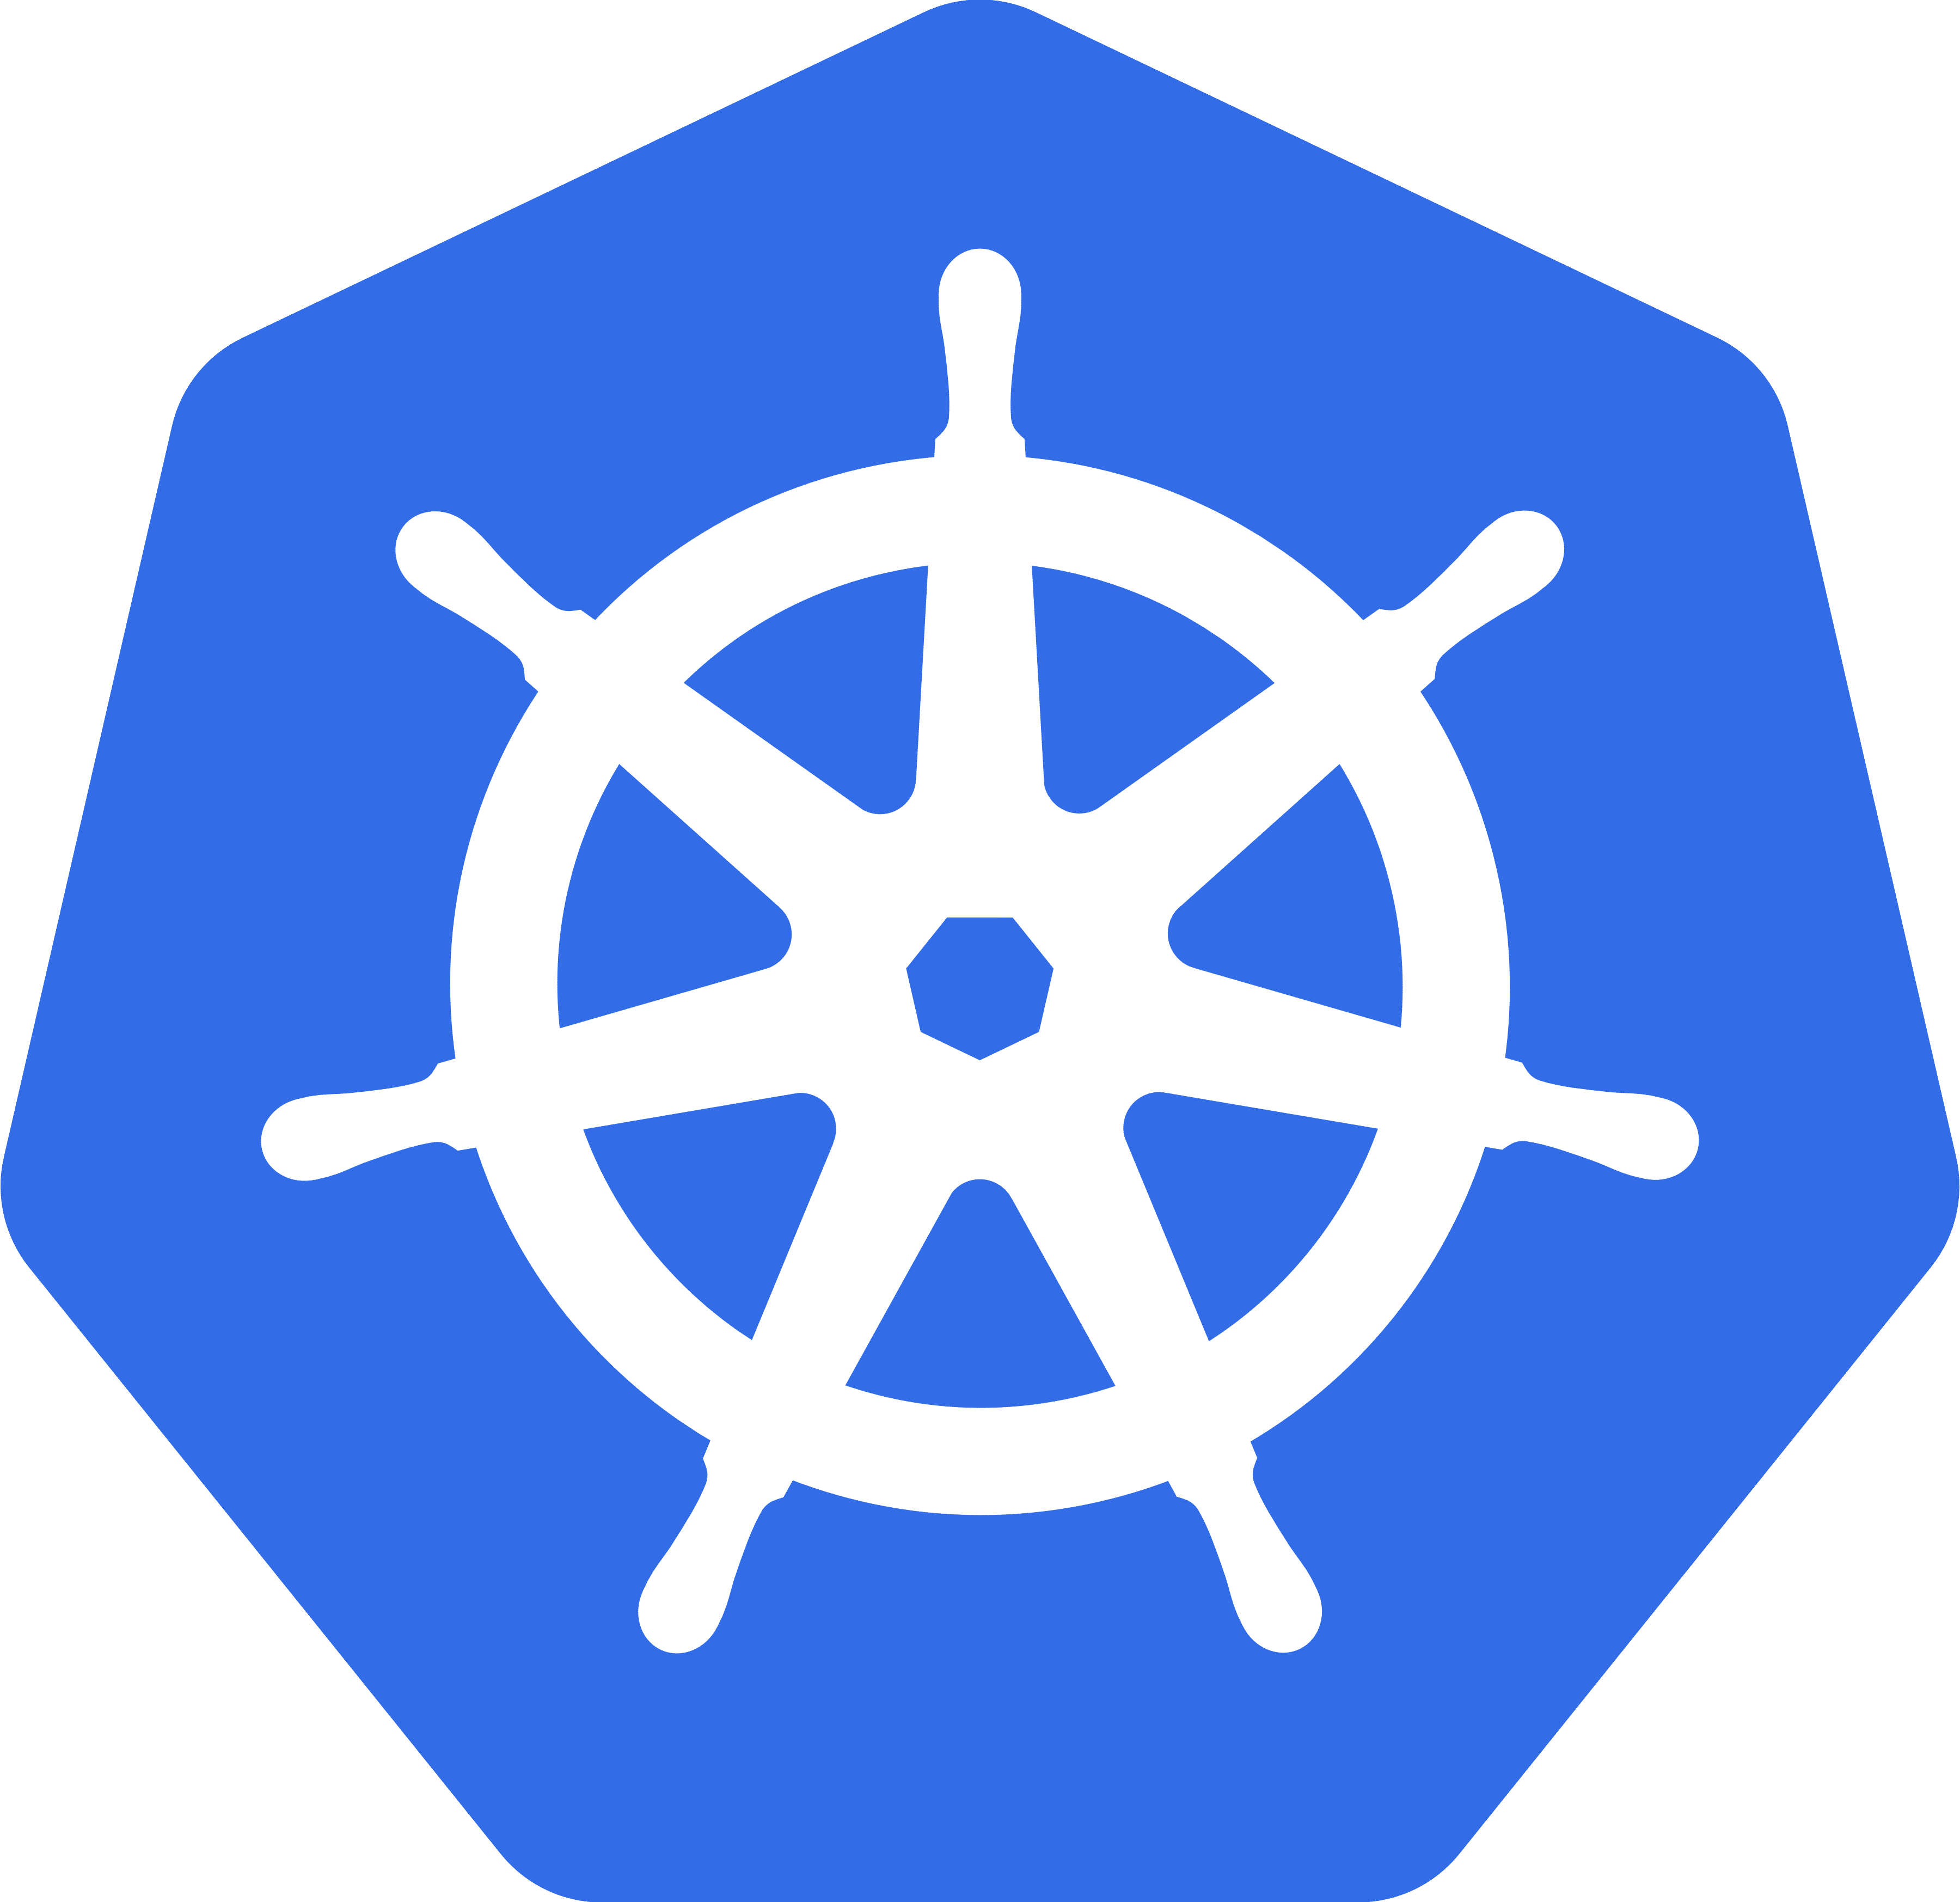

Your Work / Kubernetes’ Work
What Kubernetes Will Do
What You Need To Do / Setup
(i.e. what Kubernetes requires)
Create your objects (e.g. Pods) and manage them
Monitor Pods and re-create them, scale Pods etc.
Kubernetes utilizes the provided (cloud) resources to apply your configuration / goals
Create the Cluster and the Node Instances (Worker + Master Nodes)
Setup API Server, kubelet and other Kubernetes services / software on Nodes
Create other (cloud) provider resources that might be needed (e.g. Load Balancer, Filesystems)

Slide 23
Installation
Cluster
Master Node
Also install all required “software” (services)
kubectl
Worker Node
A tool for sending instructions to the cluster
(e.g. a new deployment)
Worker Node

Slide 24
Understanding Kubernetes Objects
Kubernetes works with Objects
Pods
Deployments
Services
Volume
…
Objects can be created in two ways:
Imperatively or Declaratively

Slide 25

The “Pod” Object
The smallest “unit” Kubernetes interacts with
Contains and runs one or multiple containers
Pods contain shared resources (e.g. volumes) for all Pod containers
Has a cluster-internal IP by default
The most common use- case is “one container per Pod”
Containers inside a Pod can communicate via localhost
Pods are designed to be ephemeral: Kubernetes will start, stop and replace them as needed.
For Pods to be managed for you, you need a “Controller” (e.g. a “Deployment”)

Slide 26

The “Deployment” Object
Controls (multiple) Pods
You set a desired state,
Kubernetes then changes
the actual state
Deployments can be paused, deleted and rolled back
Deployments can be scaled dynamically (and automatically)
Define which Pods and containers to run and the number of instances
You can change the number of desired Pods as needed
Deployments manage a Pod for you, you can also create multiple Deployments
You therefore typically don’t directly control Pods, instead you use Deployments to set up the desired end state

Slide 27

The “Service” Object
Exposes Pods to the Cluster or Externally
Pods have an internal IP by default – it changes when a Pod is replaced
Services group Pods with a shared IP
Services can allow external access to Pods
Finding Pods is hard if the IP changes all the time
The default (internal only) can be overwritten
Without Services, Pods are very hard to reach and communication is difficult
Reaching a Pod from outside the Cluster is not possible at all without Services

Slide 28
Imperative vs Declarative Kubernetes Usage
Imperative
Declarative
kubectl create deployment …
Individual commands are executed to trigger certain Kubernetes actions
Comparable to using docker run
only
kubectl apply –f config.yaml
A config file is defined and applied to change the desired state
Comparable to using Docker Compose with compose files

Slide 29
Understanding “State”
State is data created and used by your application which must not be lost
User-generated data, user accounts, …
Intermediate results derived by the app
Often stored in a database, but could also be files (e.g. uploads)
Often stored in memory, temporary database tables or files
Volumes

Slide 30
Kubernetes & Volumes
Kubernetes can mount Volumes into Containers
A broad variety of Volume types / drivers are supported
Volume lifetime depends on the Pod lifetime
Volumes survive Container restarts (and removal)
Volumes are removed when Pods are destroyed
”Local” Volumes (i.e. on Nodes)
Cloud-provider specific Volumes

Slide 31
Kubernetes Volumes vs Docker Volumes
Kubernetes Volumes
Docker Volumes
Supports many different Drivers and Types
Volumes are not necessarily persistent
Volumes survive Container restarts and removals
Basically no Driver / Type Support
Volumes persist until manually cleared
Volumes survive Container restarts and removals

Slide 32
Persistent Volumes
Volumes are destroyed when a Pod is removed
hostPath partially works around that in “One- Node” environments
Pod- and Node-independent Volumes are sometimes required
Persistent Volumes

Slide 33
Persistent Volumes & Persistent Volume Claims
Cluster
Node
Persistent Volume (PV)
Pod
Pod
PV Claim
Node
Persistent Volume (PV)
Pod
Pod
PV Claim

Slide 34
“Normal” Volumes vs Persistent Volumes
Volumes allow you to persist data
”Normal” Volumes
Persistent Volumes
Volume is attached to Pod and Pod lifecycle
Volume is a standalone Cluster resource (NOT attached to a Pod)
Defined and created together with Pod
Created standalone, claimed via a PVC
Repetitive and hard to administer on a global level
Can be defined once and used multiple times

Slide 35

Networking Demo Application
Cluster
Pod
Pod
Cluster-internal
Auth API
NOT public-facing
Cluster-internal
Pod
Users API
Client
(e.g. Postman)
Tasks API

Slide 36
Deployment Options
Custom Data Center
Cloud Provider
Install + configure everything on your own
Install + configure most things on your own
Use a managed service
Kubernetes Software
Create + connect machines
Install + configure software
Define cluster architecture
Machines
Manually or via kops etc
Services like AWS EKS

Slide 37
AWS EKS vs AWS ECS
AWS EKS
(Elastic Kubernetes Service)
AWS ECS
(Elastic Container Service)
Managed service for Kubernetes deployments
No AWS-specific syntax or philosophy required
Use standard Kubernetes configurations and resources
Managed service for Container deployments
AWS-specific syntax and philosophy applies
Use AWS-specific configuration and concepts

Slide 38
AWS EKS Deployment Steps
Create Cluster + Nodes
Connect kubectl to AWS EKS Cluster
kubectl apply …
Optional: Add additional AWS resources (e.g. AWS EFS)

Slide 39
Rancher
https://rancher.yougov.net/

Slide 40
Harbour
https://registry.yougov.net/harbor/projects

Slide 41
HELM
Helm is a tool that streamlines installing and managing Kubernetes applications. https://confluence.yougov.net/display/EP/Helm

